Slide 1
Accessibility Program Managers Meeting Welcome!

Slide 2
February 2020 Accessibility Program Managers Meeting
Moving Forward
Yvette Gibson | February 4, 2020
Notes:
SAMPLE COVER

Slide 3
Accessibility Program Managers Meeting
February 2020 - Moving Forward
Agenda:
Welcome / Moving Forward
Breaking The Ice
Section 508 Program Maturity Bi-annual Reporting
2020 GSA & ACoP/Access Board Training Updates
Break
Forward: A 508 Program On The Move
508 Roundtable Discussion
Closing

Slide 4
Breaking the Ice
Accessibility Program Managers Meeting
Avis Ryan | February 4, 2020

Slide 5

10 Things We Have in Common
Breaking the Ice
Break up into smaller groups of 6 people
Be sure to include people from different agencies
Finding as many things that you each share in common
Take about 20 minutes
Share what you discovered
If your team has the most items in common, the group wins a prize!

Slide 6
Section 508 Program Maturity Bi-annual Reporting
Accessibility Program Managers Meeting
Michael Horton | February 4, 2020
Notes:
SAMPLE COVER

Slide 7
Topics
Section 508 Program Maturity Bi-annual Reporting
Year-end 2019 Section 508 Program Maturity Report Summary
February 2020 Section 508 Program Maturity Report
Accessibility Challenges

Slide 8
Year-end 2019 Section 508 Program Maturity Report Summary

Slide 9
Year-end 2019 Section 508 PMR
Internal meeting discussion. This section has been left blank on purpose.

Slide 10
February 2020 Section 508 Program Maturity Report

Slide 11
February 2020 Section 508 PMR
Monitor and Report Progress
Questions remain the same as the past three report cycles
Email invitations were sent out on Friday, January 24
Email was sent to agency Section 508 PM & IDC POC on record
Reporting is required for all CFO Act agencies, and is recommended for all other Executive Branch agencies
If you didn’t receive an email, please look in email junk folder:
Subject: Instructions - February 2020 Section 508 Program Maturity Reporting
From: ogpsurveysupport@research.gsa.gov

Slide 12

February 2020 Section 508 PMR
Monitor and Report Progress (Continued)
A reminder email is scheduled for Monday, Feb. 10
All agency reports are due COB Tuesday, Feb. 18
Information is on Section508.gov » Manage an IT Accessibility/508 Program » IT Accessibility Program Management » Monitor and Report Progress
Section508.gov/manage/reporting
Section508.gov/manage/reporting/questions

Slide 13

Part 1: Agency Information
OMB Reporting Questions
Agency Name
Submitter Name
Number of Federal Employees responsible for supporting Section 508 Program
Number of Contractors responsible for supporting Section 508 Program

Slide 14
Part 2: Program Maturity Metrics
Program Maturity Reporting Questions
Please indicate the maturity level that best reflects your organization’s overall status in the following areas for the current reporting cycle.
Acquisition - Review procurement solicitations to ensure Section 508 contract language is incorporated into Statements of Work and Performance Work Statements.
Technology Lifecycle Activities - Ensure 508 requirements are incorporated into technology lifecycle activities, including enterprise architecture, design, development, testing, deployment, and ongoing maintenance activities.
Testing and Validation - Test and validate Section 508 conformance claims.
Complaints Process - Track and resolve incoming Section 508 complaints.
Training - Train stakeholders on roles and responsibilities related to Section 508 compliance.

Slide 15

Part 3: Website Compliance Metrics
Program Maturity Reporting Questions
Provide the number (#) evaluated and percentage (%) conformant with technical standards for the current reporting cycle.
Number of Internet web pages evaluated (numeric value only - no commas)
Percent (%) of Internet web pages found to be conformant (numeric value only - no percentage sign)
Number of Intranet web pages evaluated (numeric value only - no commas)
Percent (%) of Intranet web pages evaluated (numeric value only - no percentage sign)

Slide 16
Accessibility Challenge

Slide 17

Mental Break / Optical Illusion

Slide 18
Web Issues Challenge - Update
Internal meeting discussion. This section has been left blank on purpose.

Slide 19
PDF Downloads Challenge
Overview
Building on the success of the web issues challenge, we now challenge agencies to reduce by 10% the number of non-conformant PDF documents among your “top 10 downloads” by March 31, 2020.
We tested PDF files among those found in the “Top-10 downloads yesterday” (DAP) using the Accessible Electronic Document (AED) Community of Practice (CoP) PDF Testing and Remediation Guide.
Testing was done using Adobe Acrobat Pro DC.
PDFs were marked as non-conformant if the document contained no tags, or where one issue of non-conformance was identified.

Slide 20
PDF Downloads Challenge
CFO Act Agency Results
Internal meeting discussion. This section has been left blank on purpose

Slide 21
PDF Downloads Challenge
How to Get a “Top Downloads” Report
While web content managers should have access to Digital Analytics Program (DAP) data for their websites, accessibility stakeholders may obtain publicly-available data through analytics.usa.gov.
To obtain a report on the top downloads for your agency, go to analytics.usa.gov, then:
1. Select your agency from the All Participating Websites dropdown,
2. Select the Data hyperlink in the upper right-hand corner, and
3. Select the CSV button to the right of “Top downloads yesterday.”

Slide 22
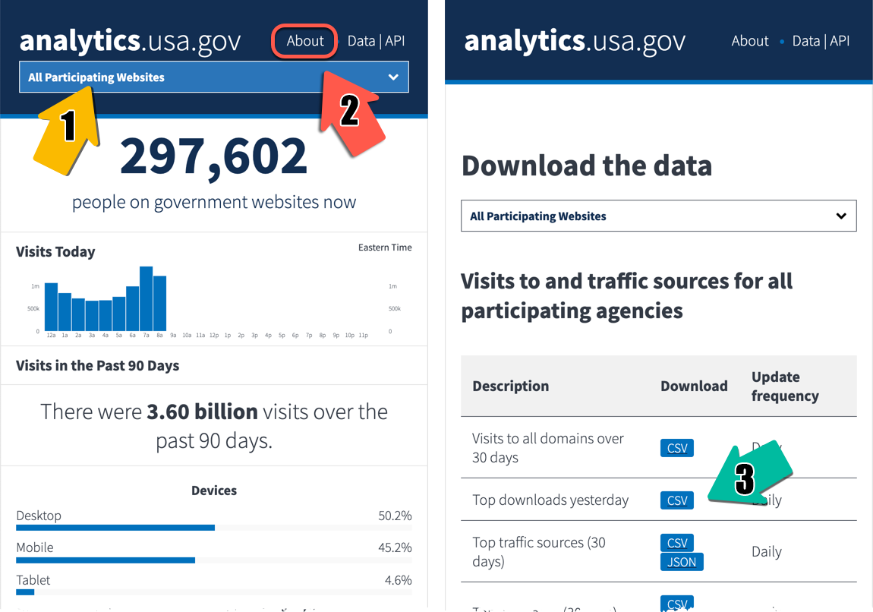
PDF Downloads Challenge
How to Get a “Top Downloads” Report (continued)

Slide 23
PDF Downloads Challenge
Recommendations and Considerations
Collaborate with web managers and other key stakeholders and plan how to remediate existing PDF documents.
Review and update applicable policies and procedures to verify that new documents are accessible, prior to publication; also confirm accessibility of external documents before linking to them.
Review and update publishing tools and training to ensure that accessibility requirements and best practices integrate into existing publishing workflows; accessibility is not an add-on.
Increase awareness and ensure that training and technical support is available for content contributors and document authors.

Slide 24
2020 GSA & ACoP/Access Board Training Updates
Accessibility Program Managers Meeting
John Sullivan & Tim Creagan | February 4, 2020
Notes:
SAMPLE COVER

Slide 25
2020 Section 508 Training Updates
Contact us: 508@access-board.gov
CIOC Section 508 Best Practices webinar series, 2013 – present.
Bi-monthly – Jan., March, May, July, Sept., November
Attendee credit available, real time Q&A
accessibilityonline.org/cioc-508/schedule
March 31, 2020: Accessible Social Media
Individualized training available – contact us: 508@access-board.gov

Slide 26



2020 Section 508 Updates
Get Involved!
PDF Challenge
2020 Interagency Accessibility Forum
CSUN Assistive Technology Conference
21st Century Integrated Digital Experience Act - activities

Slide 27
Forward: A 508 Program On The Move
Accessibility Program Managers Meeting
Joy Coudhury, Lawrence A. Malakhoff, and
David J. Whittington - U.S. Census Bureau
February 4, 2020
Notes:
SAMPLE COVER

Slide 28
Forward: A 508 Program On The Move
Presented by the Census Bureau
The file for this portion of the training event is available as a separate download at:
https://www.section508.gov/training/presentations-workshops

Slide 29
508 Roundtable Discussion
Accessibility Program Managers Meeting
Yvette Gibson | February 4, 2020
Notes:
SAMPLE COVER

Slide 30

Program Managers
Do you have experience developing or leading an accessibility program in the Federal government?
We need your expertise!

Slide 31

Acquisitions
Are you an acquisitions professional skilled in buying accessible ICT?
We need your expertise!

Slide 32

Technical
Do you have a strong technical background in accessibility and Section 508 issues? Are you a Trusted Tester or a developer?
We need your expertise!

Slide 33
Closing
Accessibility Program Managers Meeting
Yvette Gibson | February 4, 2020
Notes:
SAMPLE COVER

Slide 34
THANK YOU! We look forward to seeing you on APRIL 7th!

